Slide 1
A Semantic Approach to Contextual Advertising
Andrei Broder, Marcus Fontoura, Vanja Josifovski, and Lance Riedel. In Proceedings of the 30th annual international ACM SIGIR conference on Research and development in information retrieval, pp. 559-566. ACM, 2007.
Just-in-Time Contextual Advertising
Aris Anagnostopoulos, Andrei Z. Broder, Evgeniy Gabrilovich, Vanja Josifovski, and Lance Riedel. In Proceedings of the sixteenth ACM conference on Conference on Information and Knowledge Management, pp. 331-340. ACM, 2007.
Presented by Erika Siregar
CS 834 - Introduction to Information Retrieval
Fall 2016
Old Dominion University
December 1, 2016

Slide 2

Overview
Contextual Advertising
Embedding a commercial ads within the content of a web page
Analogue to conventional publishing
Page & ad must be relevant. Why??
Page
Advertisement

Slide 3
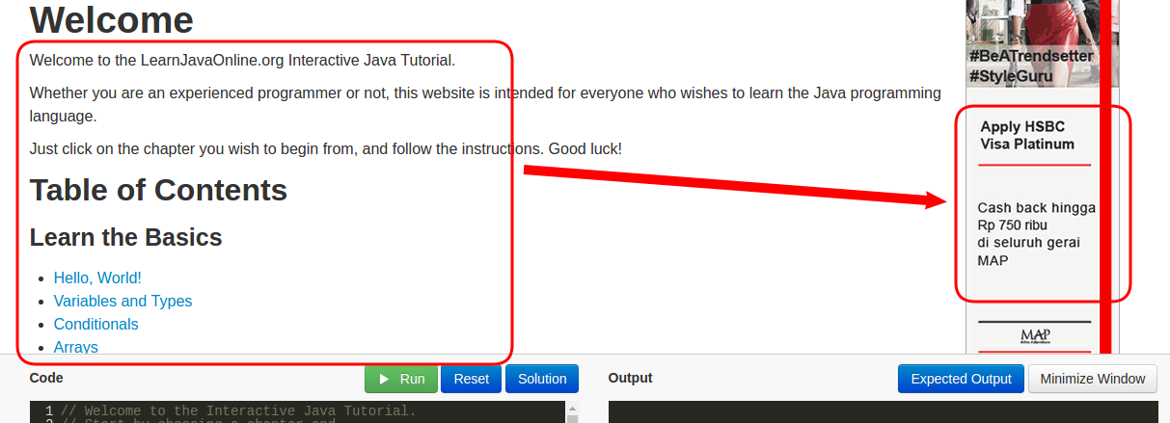
Why relevance is important?
increase the probability of user clicks → increasing revenue
Improve user’s experience

Slide 4
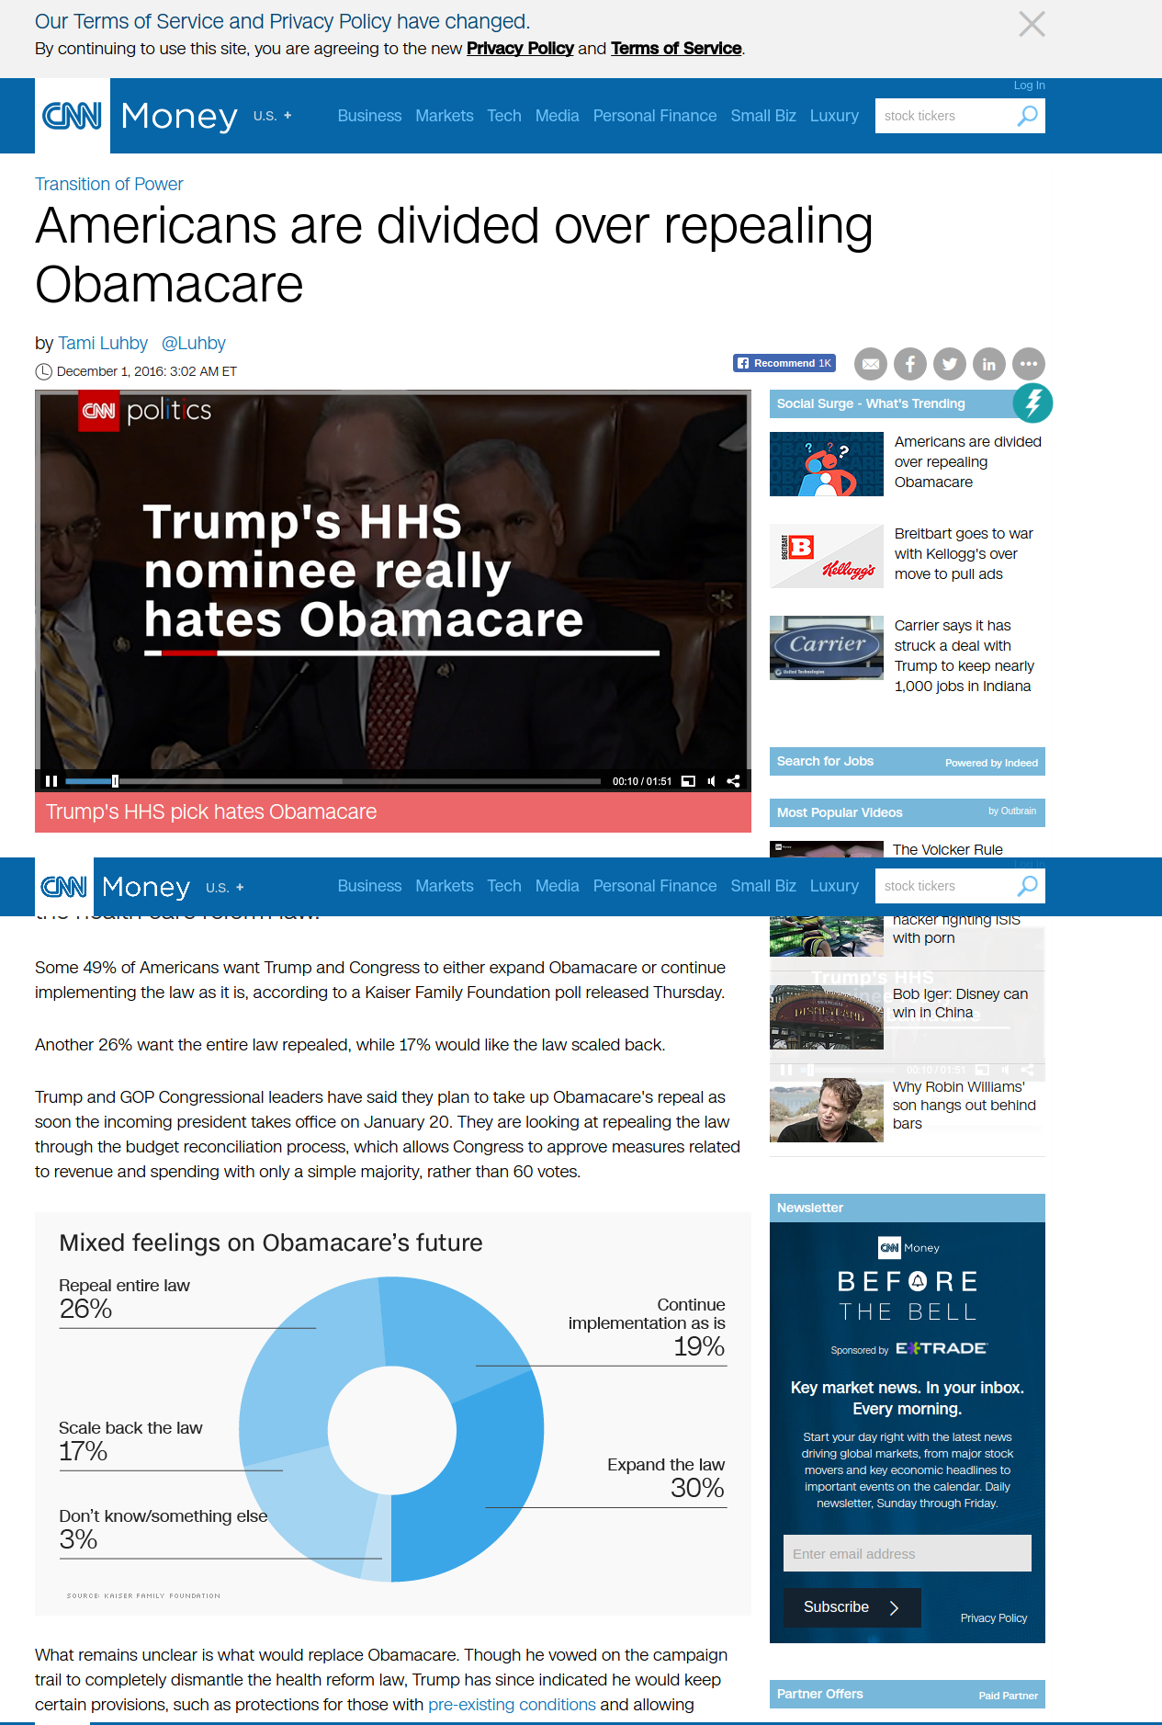


How to match pages and ads?
Syntactic approach (co-occurrence of the same words)
Bid phrases
Phrases
match?
relevant?
ads
Polysemy leads to irrelevant ads:
“Chevy Tahoe Truck” vs “Lake Tahoe Vacation”
“John Maytag” vs “Maytag dishwasher”
page
Match but not relevant

Slide 5
Can we do any better?
Syntactic
+
Semantic
YES!!!
Create hierarchical taxonomy classes
Classifies page and ads into the taxonomy classes
Use similarity measure (cosine) to do the match
Semantic-Syntactic Matching
Syntactic refers to grammatical structure
Semantics refers to the meaning of the vocabulary symbols arranged with that structure
Favor ads that are topically related to the page

Slide 6
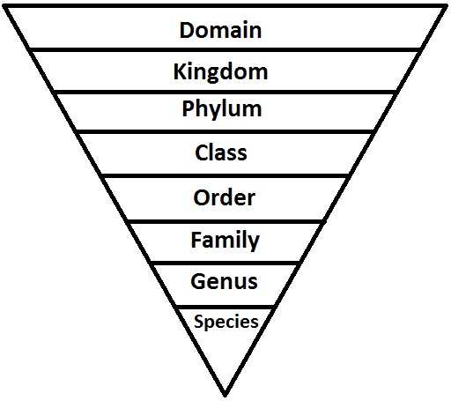
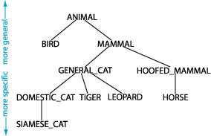
Taxonomy Choice
Classification
The semantic match of the pages and the ads is performed by classifying both into a common hierarchical taxonomy.

Slide 7
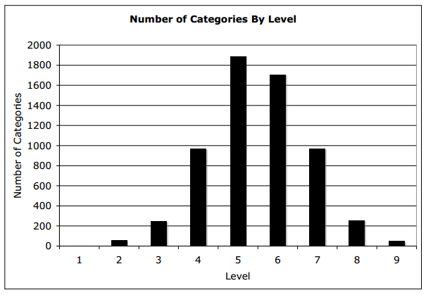
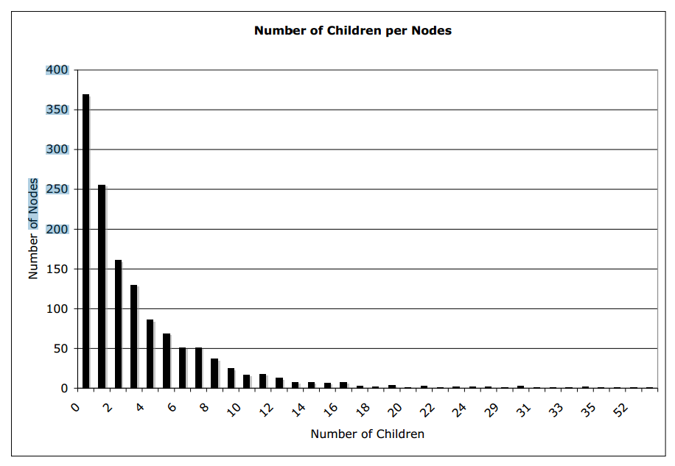
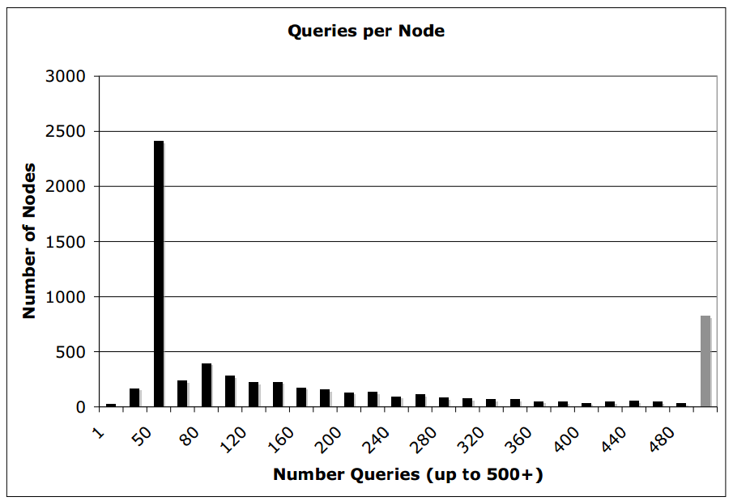
Taxonomy Statistics
Classification
This research use taxonomy built by Yahoo! US
The taxonomy is represented as a group of nodes
Each node represents a topic
Each node contains ± 100 queries
Categories per level
Fanout for non-leaf nodes
Queries per node

Slide 8
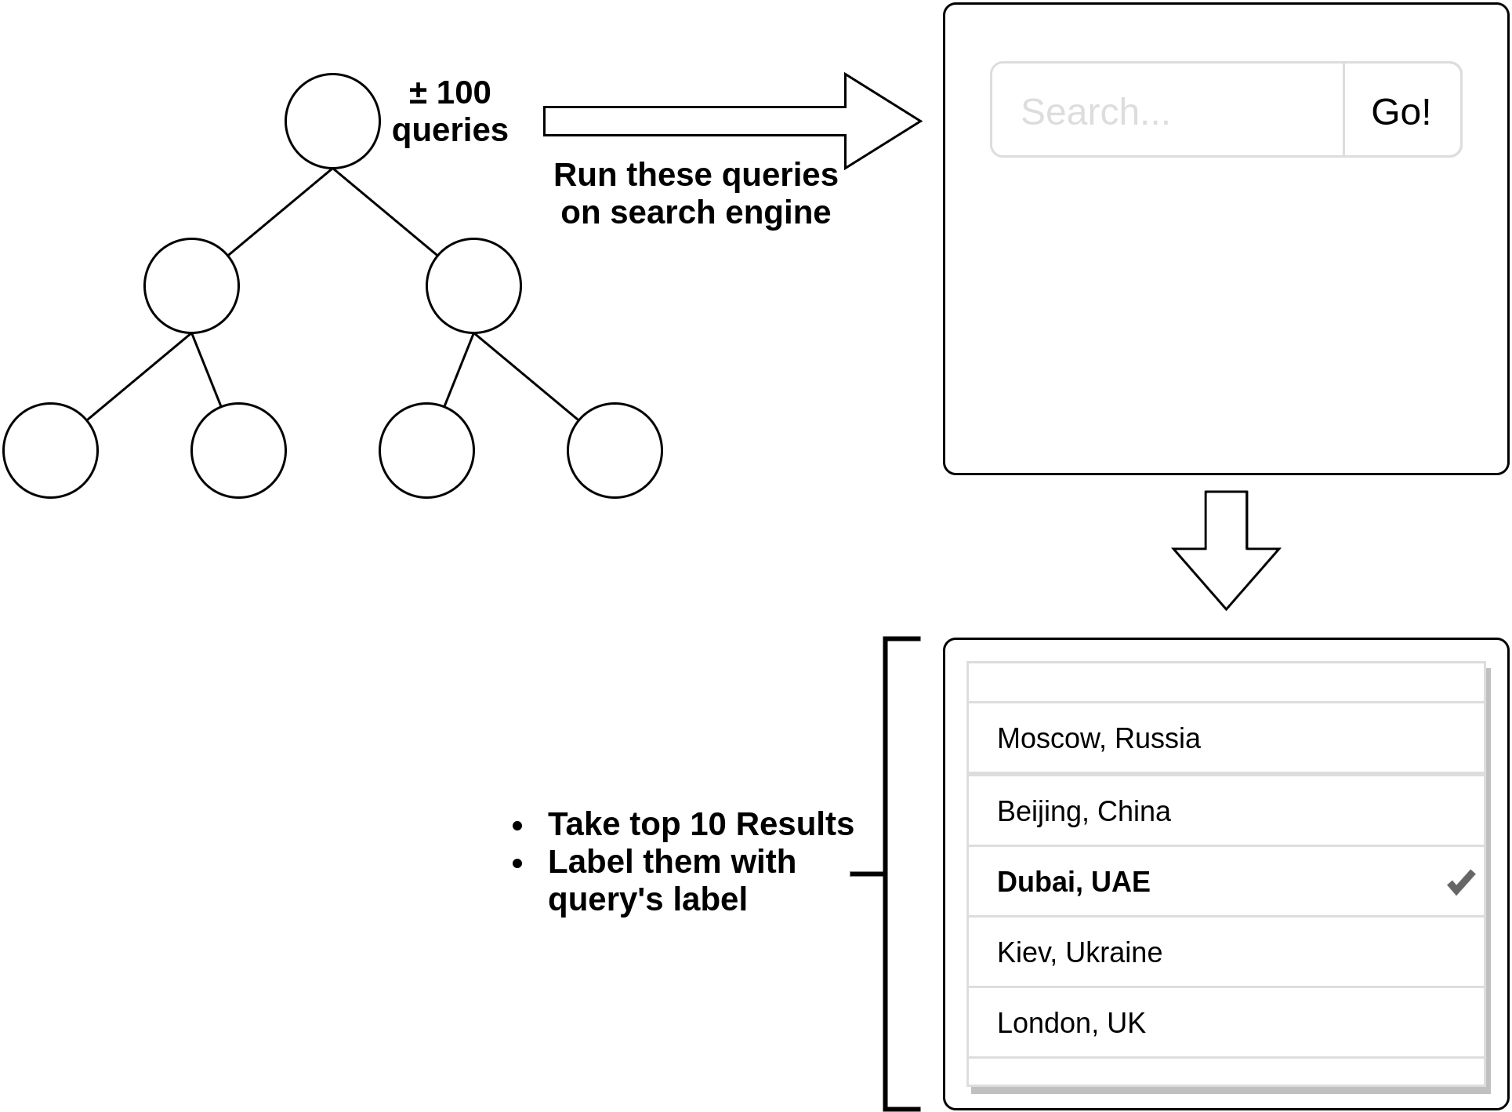
Generate training data
Classification
For pages :
For ads :
For each node in the taxonomy:
Select ads whose bid phrase match the topic in the node

Slide 9
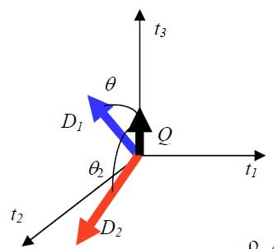
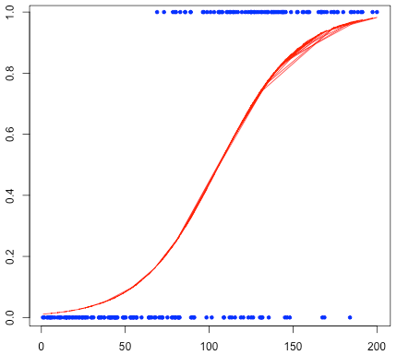
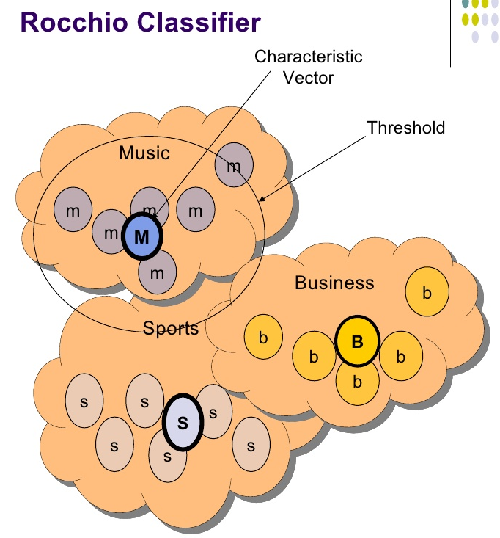
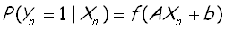
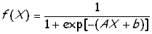
Classification Method
Classification
Hierarchical VSM
(one against all)
Rocchio’s Nearest Neighbor
Log Regression
Notes:
Contoh VSM : https://liyantanto.wordpress.com/2011/06/28/pencarian-dengan-metode-vektor-space-model-vsm/
Slide Log Regression : http://slideplayer.com/slide/8076526/
Rocchio’s Nearest Neighbor : http://www.slideserve.com/regis/k-nearest-neighbor-and-rocchio-algorithm

Slide 10
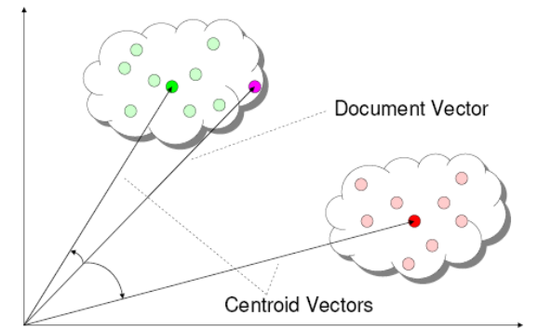
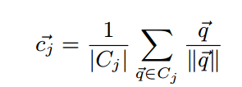
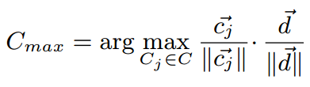
Choosing Classification Method
Classification
SVM and log-regression classifier are very slow to classify an item into 1 of 6,000 possible classes.
Rocchio’s classifier gave the best performance.
The centroids are calculated by adding up the tf-idf of all queries in each node.
These centroids are called “meta-documents”
Classification is based on the cosine of the angle between document d and the centroid.

Slide 11
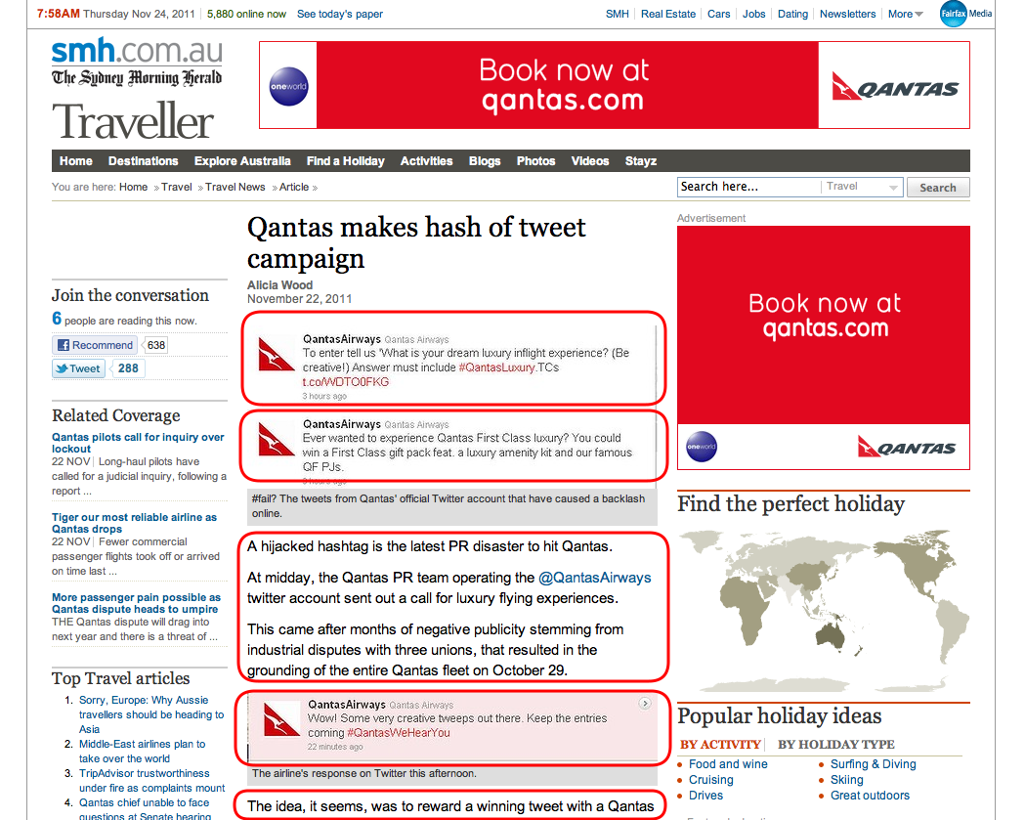
Semantic - Syntactic Matching
→ Process the content of the page → Extract features → Search the ad space to find the
best matching ads
Page section
Page word
Ads

Slide 12
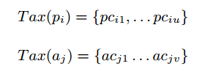
How does it work?
Semantic - Syntactic Matching
Match every page in the set P = {p₁, . . . p_{n}} to every ads in the set A = {a₁ . . . a_{m}}
A page/ad = a set of sections = a set of terms So that: p_{i} = (pw₁^{s1}, pw₂^{s2}, …, pw_{n}^{si}) and a_{i} = (aw₁^{s1}, aw₂^{s2}, …, aw_{n}^{si})
Calculate TF-IDF for each term in page and ad.
Combine the impact of term’s section and its TF-IDF:
From the classification steps, we obtained 2 sets:

Slide 13
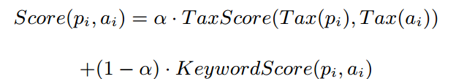
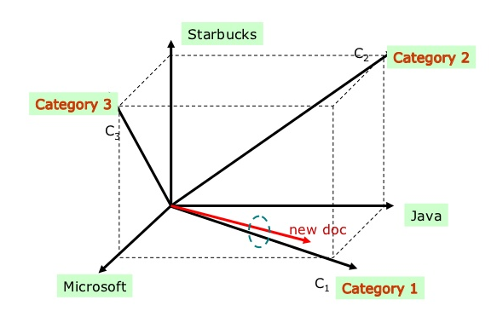
How does it work?
Semantic - Syntactic Matching
Calculate the relevance score between page p_{i} and ad a_{j} → combining the syntactic (keyword score) and semantic (taxonomy score) aspects. → The formula:
Keyword score = cosine of the angle between the page and ad vectors.
𝝰 = Tax Score
Keyword Score
Pages and ads are represented as vectors in n-dimensional space

Slide 14
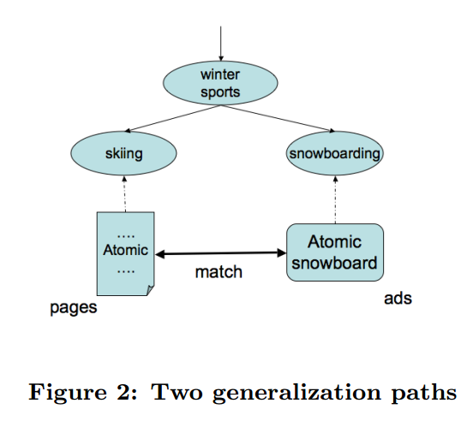
How does it work?
Semantic - Syntactic Matching
Tax score → indicate the topical match between pages and ads. → topics are organized into hierarchy → benefit: allow gradual generation of the ad search space in case there are no matched ads. → example:

Slide 15
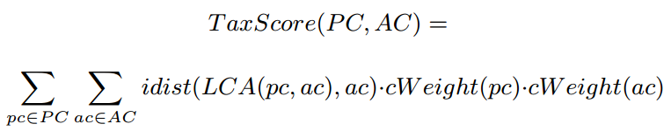
How does it work?
Semantic - Syntactic Matching
The formula for taxonomy score:
Tax Score (p_{i}, a_{j}) = 𝝨𝝨 x * y * z
→ y & z = the weight of the taxonomy class for p and a. It is defined by the classifier → x = inverse distance (idist) between the LCA of page & ad class and the ad class
→ 0 ≤ idist ≤ 1 → idist = 1, means the page and ad come from the same class → idist = 0 means the LCA of page and ad is the root.

Slide 16
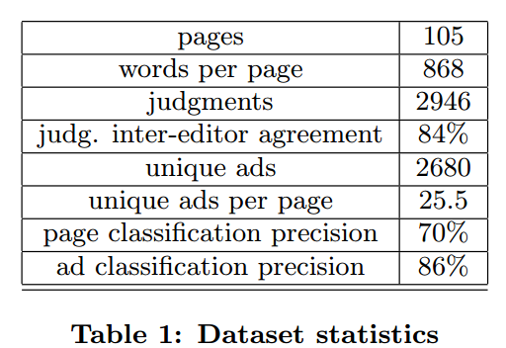
Experiment: Data and Methodology
Using a set of 105 pages (randomly sampled from 20 million pages)
Ads are chosen from previous experiment conducted by Yahoo! US.
Each page-ad pairs are judged by human judges on a 1 to 3 scale.
Relevant E.g: page = The National Football League; ad = tickets for NFL games
Somewhat relevant E.g: page = The National Football League ; ad = NFL branded products
Irrelevant E.g: page = The National Football League ; ad = the NFL player “John Maytag” triggers washing machine ads on a NFL page.

Slide 17
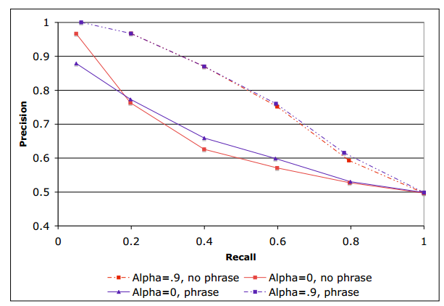
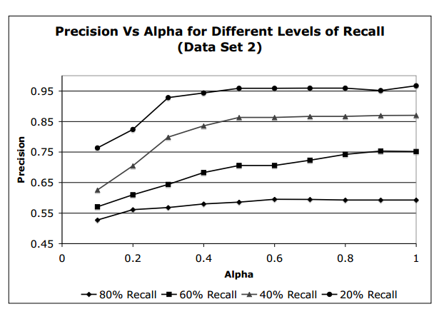
Experiment: Results
Solid line = syntactic
Dashed line = semantic-syntactic
Figure 3. Precision vs. Recall of syntactic match (α = 0) vs. syntactic-semantic match (α = 0.8)
Figure 4: Impact of α on precision for different levels of recall
Precision grows or is flat when 𝝰 is increased, except for the low level of recall (small number of data points)
→ semantic component provides largest lift in precision → when the precision is hight (keyword match is strong), syntactic method is comparable twith semantic-syntactic method

Slide 18

But...
Experiment in paper 1 relied on assumption that the pages are static.
Matching of ads can be based on prior analysis
But how about dynamic pages that cannot be processed ahead of time ??

Slide 19
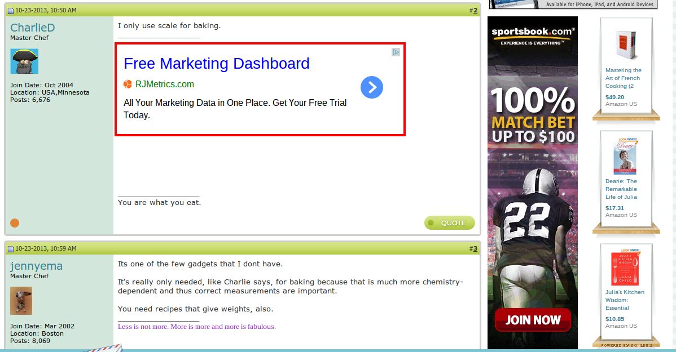
Background
2nd Paper - JIT Contextual Ads
Static page → The matching of ads can be based on prior analysis of the entire content
Dynamic page → Analyzing the entire body of such pages on the fly entails prohibitive communication and latency costs
Dilemma → low-relevance vs high-latency and high-load

Slide 20
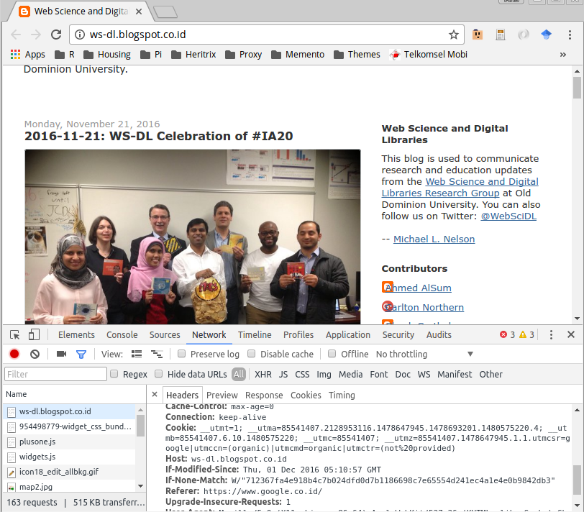
Solutions
2nd Paper - JIT Contextual Ads
Web page Title
Web page URL
Text Summarization + External Knowledge
Excerpts of page text that are representative of the entire page content
Metadata of page → URL, Referer URL, Title
Balances the two conflicting requirements → dilemma
Analyzing as much page content as possible for better ad match, vs.
Analyzing as little as possible to save transmission and analysis time
URL Referer

Slide 21
Text Summarization
2nd Paper - JIT Contextual Ads
Page components candidates in constructing summaries:
Title (T)
Meta keywords and description (M)
Headings (H): the contents of <h1> and <h2> HTML tags, as well as captions of tables and figures
Tokenized URL of the page (U)
Tokenized referrer URL (R)
First N bytes of the page text (e.g., N = 500) (P<N>, e.g., P500) → determined based on experiment
Anchor text of all outgoing links on the page (A)
Full text of the page (F)
Techniques:
Extractive → by taking carefully selected terms and phrases that are already present in the document
Non-Extractive → analyzes the entire document as a whole and rewrites its content in a more concise way
Extractive approach is adopted, since non-extractive approach is very expensive

Slide 22
External Knowledges
2nd Paper - JIT Contextual Ads
Techniques:
Tokenize the page URL into individual words. Premise : Page URLs often contain meaningful words that are relevant to the page content
Analyze the Referrer URL → the URL from where the user arrived to the current page. Premise : Referer URL might contain relevant words that to some extent capture the user intent
Combine the text summary with the external knowledges
Then, do the classification using Rocchio’s Classifier (similar with paper 1)

Slide 23
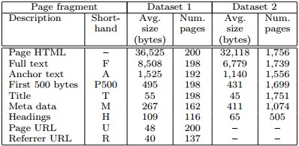
Evaluation
2nd Paper - JIT Contextual Ads
Dataset :
Evaluation Algorithm : 5 Different Combination of page’s parts
Full text (F)
Full-text + page URL + referrer URL (F-U-R)
Page title (T)
Page URL, referrer URLs, title, meta data, and headings (U-R-T-M-H)
Title-Meta-Headings summary with anchor text and the first 500 bytes of the page text (T-M-A-H-P500)
Evaluation Method :
Using Human Judgements
Data test : 12,000 page-ad pairs
Each pair judged by three or more human judges
Scale : 1 - Relevant, 2 - Somewhat Relevant, 3 - Irrelevant

Slide 24
Evaluation: Result
2nd Paper - JIT Contextual Ads
The U-R-T-M-H method (Page URL, referrer URLs, title, meta data, and headings) appears to be the most cost-effective option. It achieves high relevance scores by analyzing only a few short page excerpts
Experimental findings confirm that:
using only a small portion of the page text can yield highly relevant ads
The quality of summary-based ad matching is competitive with that of using the full page.
For Dataset 1, using only 5% of the page text can still yield 97%–99% of the full-text-based relevance (94%–99% for Dataset 2).

Slide 25
Conclusion
Based on Paper 1 and Paper 2:
Relevance is the main success factors for contextual ads
Syntactic-semantic approach increased the matched precision of page-ad pairs.
Text summarization techniques can be used to build short page summaries that can be used as a good proxy for the entire page.
Empirical evaluation proves that matching ads on the basis of such summaries does not sacrifice relevance, and is competitive with matching based on the entire page content

